Slide 1

Customer Report:

Slide 2
Customer Report Analysis:
In today’s competitive business environment, understanding customer behavior is crucial for driving growth and improving customer satisfaction. this Customer Report, created using Power BI, provides a comprehensive analysis of customer trends, purchase patterns, and key metrics that help businesses make data-driven decisions. By leveraging interactive visualizations and dashboards, this report enables stakeholders to gain insights into customer demographics, purchasing frequency, retention rates, and overall business performance.

Slide 3
Requirements:
Business Requirements:
Customer insights,
purchase behavior,
Retention,
Customer Segmentation Analysis,
Sales Performance Tracking,
Customer Retention And Churn Analysis,
Purchase Behavior Analysis,
Customer Lifetime Value (CLV) Measurement,
Marketing Campaign Effectiveness,
Customer Satisfaction And Feedback Analysis,
Regional and Product-wise Performance,
Real-Time Data Monitoring,
Custom Reporting and Export Options.

Slide 4


Slide 5
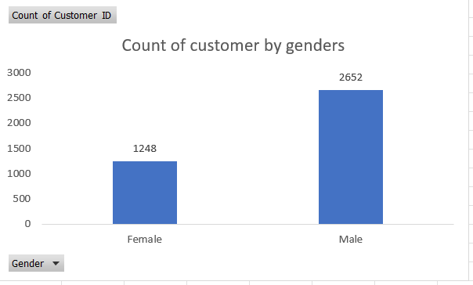
Count of customers By Genders
Here we analyzed and there are men and female participated in purchases
Here count of men are more than females

Slide 6
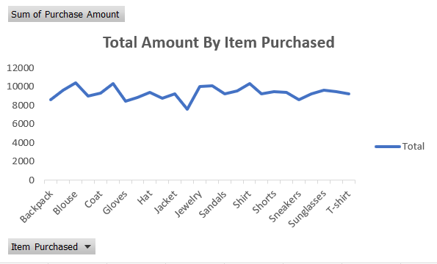
Total Amount By Item Purchased
Here we Analyzed that total purchases made as per item
The most purchases made by the item is “Blouse”.

Slide 7
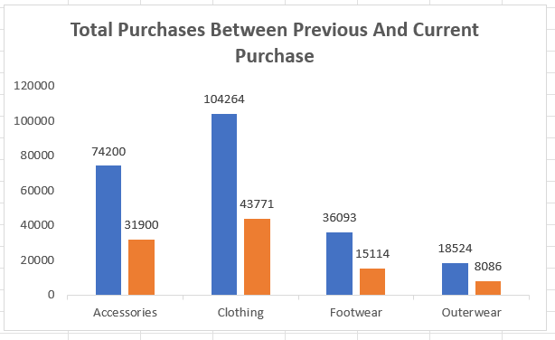
Total purchases between Previous and current purchase
Here we analyzed the total purchase amount.
And we could see that current purchases is more than the previous purchase.

Slide 8
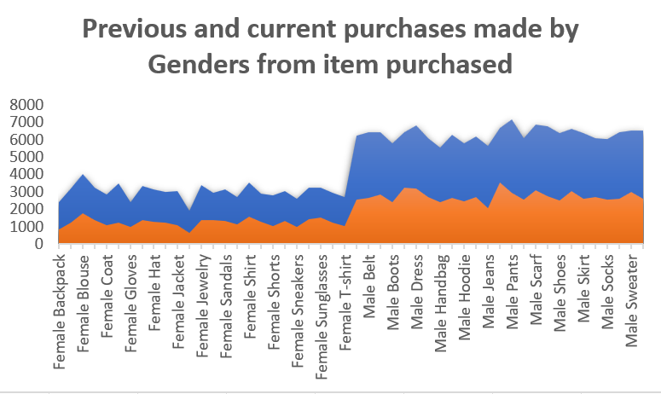
Previous and current purchases made by genders from item purchased
Here most of the purchases made by genders is male.
Has current purchase is most as per the genders and item purchased than the previous purchase.

Slide 9
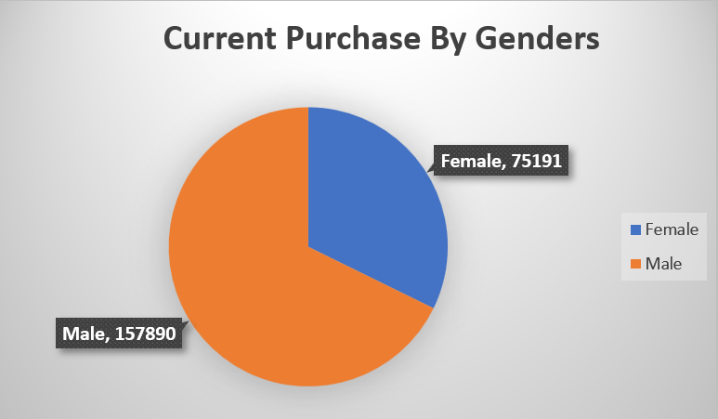
Current Purchases by Genders
Here we analyzed that the current purchases made as per the genders is male and female.
And we clearly analyzed that male has made more purchases than the female.

Slide 10
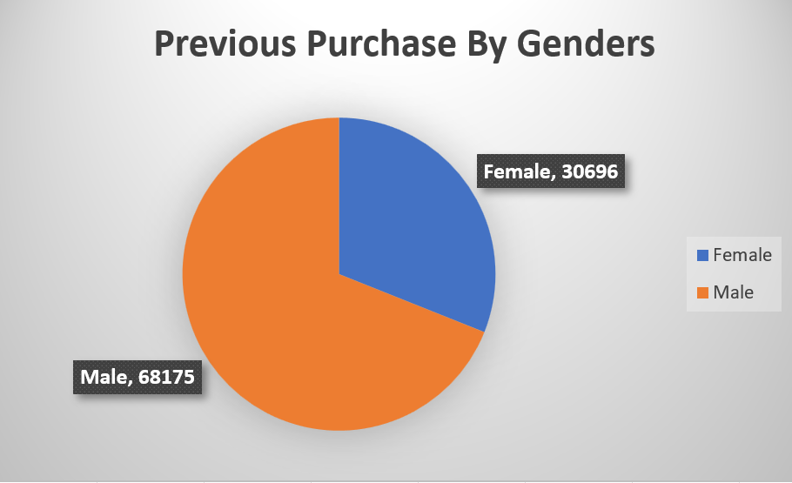
Previous purchase by genders
Here it is same as per the current purchase.
Here the male as made more purchases than the females.

Slide 11
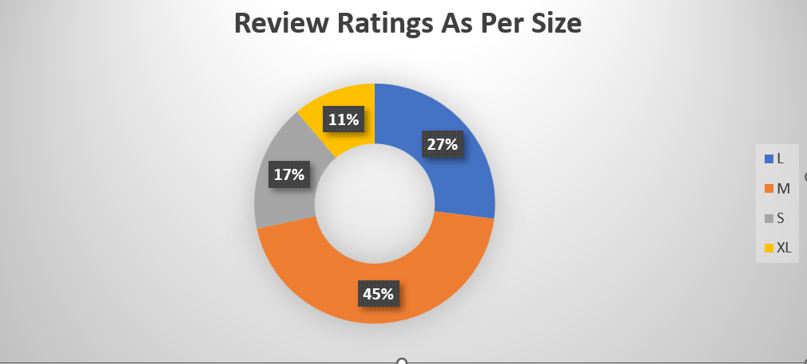
Review ratings as per size
Here we have analyzed ratings side both males and females
Has ratings company's main part of the company's growth
As per the ratings we have analyzed the size and the ratings is more in the ‘M’ size than compare to all other size.

Slide 12
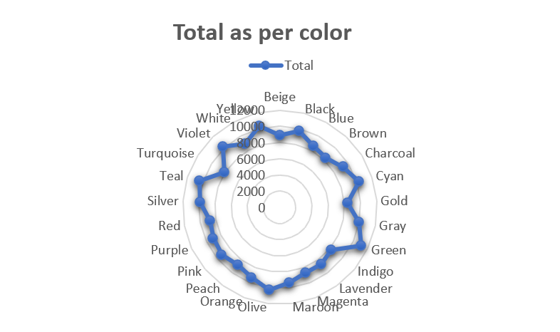
Total amount as per color
Here we analyzed as per color
And we used the purchase amount to analyze as per the colors
And here is the visualization we made and the visualization result is as shown below:

Slide 13
Dashboard:

Slide 14
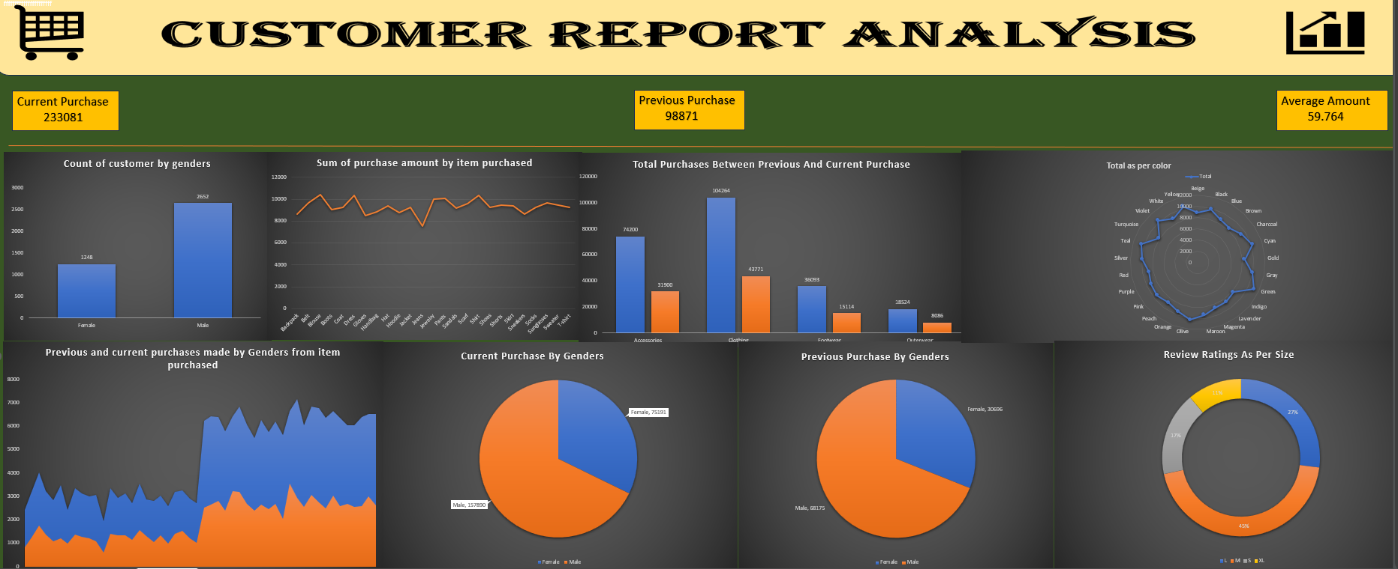

Slide 15
Conclusion:
The customer report plays a crucial role in understanding customer behavior, sales performance, and market trends.
By leveraging the shopping behavior updated dataset from Kaggle and utilizing excel dataset, this report aims to provide valuable insights to enhance customer satisfaction, improve sales strategies, and increase business profitability.
The report will focus on customer segmentation, sales performance, and retention analysis.
Enabling businesses to make data-driven decisions.
By tracking key metrics such as customer lifetime value, churn rate, and average purchase frequency, business can identify high-value customers and implement effective strategies to retain them.
Further more, real-time dashboards and interactive visualizations will help stakeholders, including the marketing, sales, and management teams, to monitor performance and make informed decisions.

Slide 16


Slide 17


